Slide 1
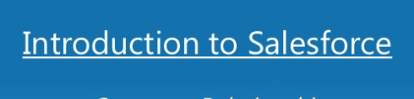
Salesforce BootCamp

Slide 2
Agenda
Why Cloud Computing and Salesforce
Salesforce Benefits to Customer
Salesforce Offerings
Releases
Concept of clicks vs coding for faster development
Salesforce Editions and license
Get started with a developer org
Move on to actual configuration of applications/objects and UI

Slide 3
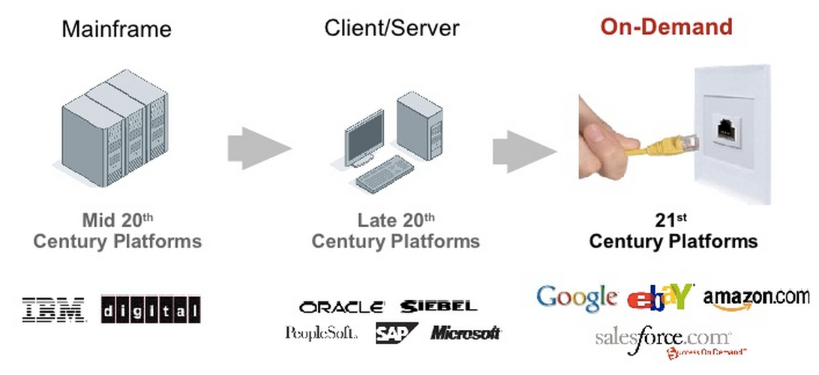
Technology change

Slide 4
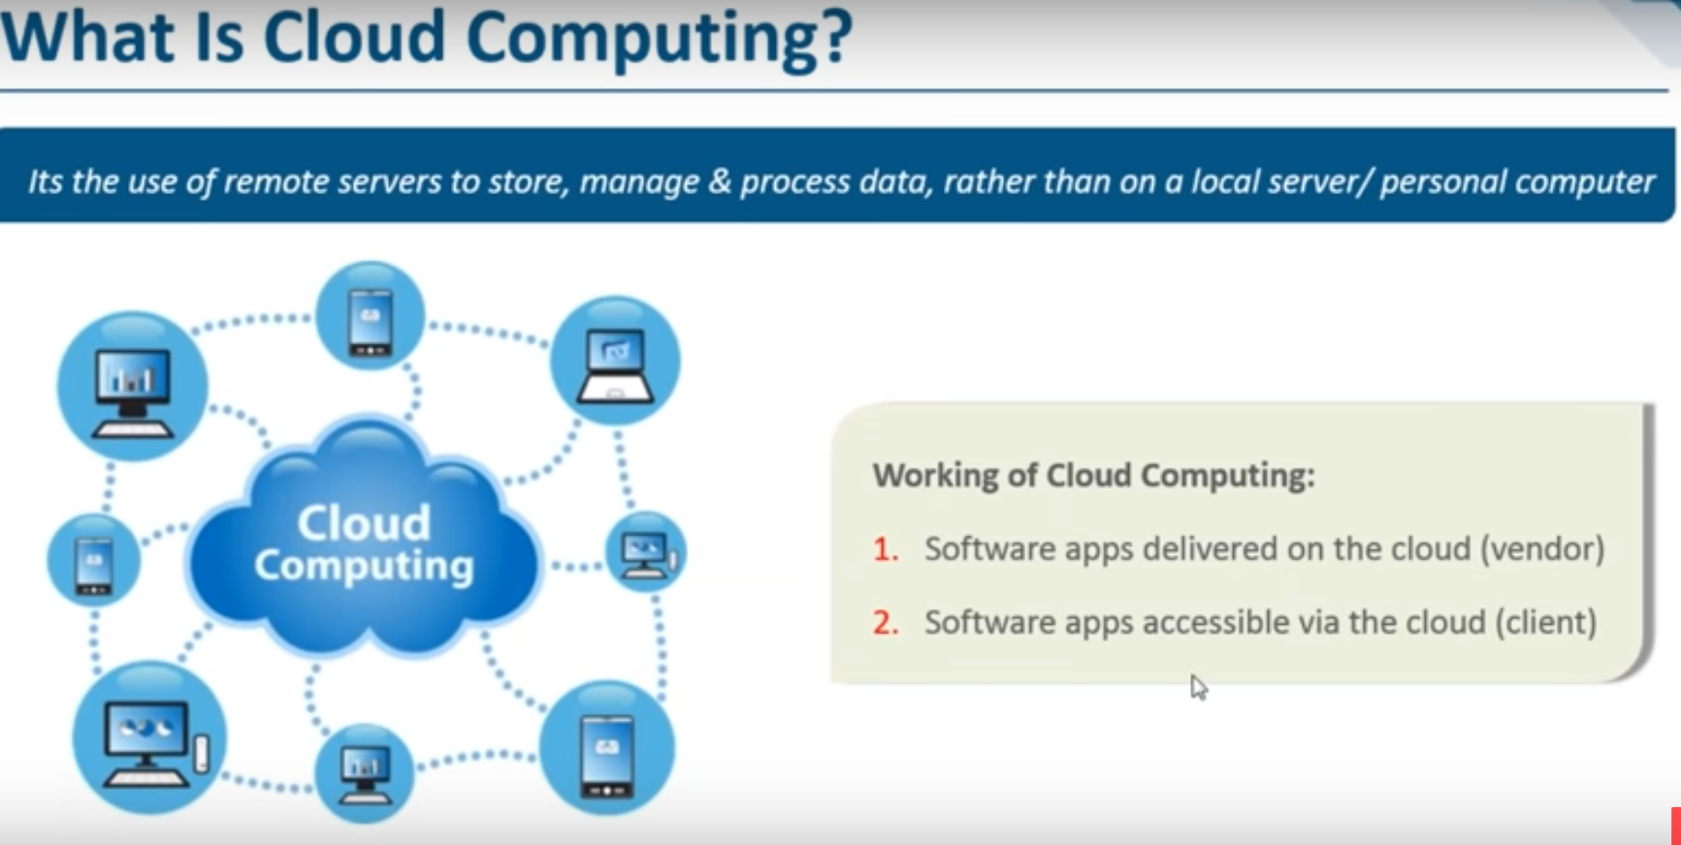

Slide 5
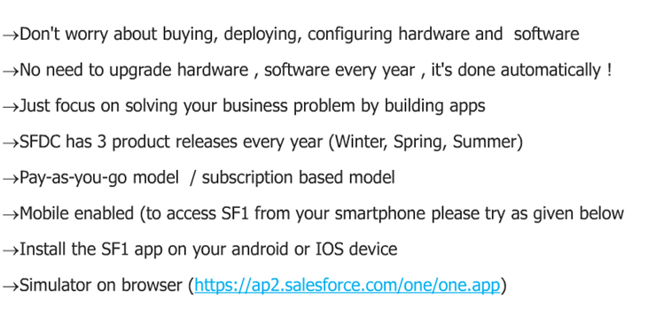
Key Benefits for Customers

Slide 6

Salesforce Applications Default Modules
Marketing Cloud
Sales Cloud
Service Cloud
Custom Apps
App Exchange
Salesforce

Slide 7
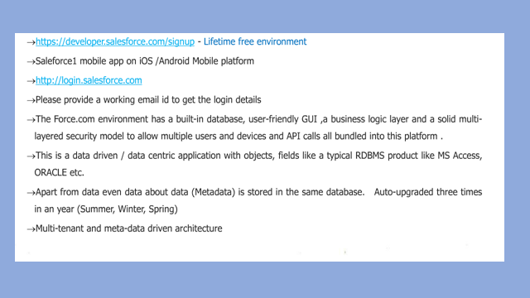
Create your developer org and Login

Slide 8
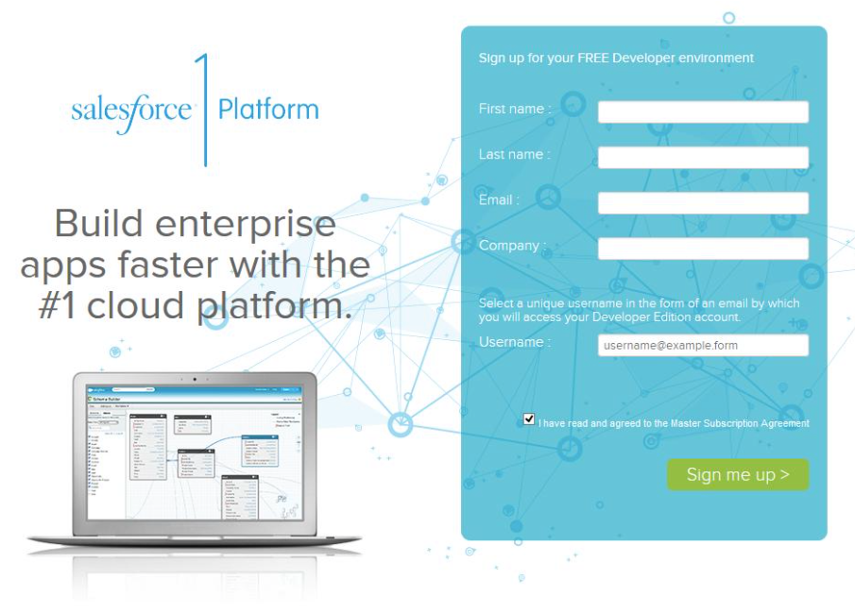
Must have
https://developer.salesforce.com

Slide 9
Navigating the SALESFORCE APP
Enable lightning experience for all users
Check OOB APPS available like sales/service
Check the Lead/accounts/Contacts tab. etc
Create few records for leads ,contacts
Navigate to Service App
Check the Cases /Contacts tabs
See the basic relationship between Accounts contacts

Slide 10
Standard database tables (sobjects) which are part of salesforce application by default
The Sales cloud: Account, Contact, Campaign, Lead, Opportunity, Quotes, Data.com, Workflow and Approvals, E-mail & Calendaring, Analytics and Partner Management.
The tables together are grouped by APP->Tab to provide specific business functionality like sales /service.
The Service cloud: Cases, Solutions, Visual Workforce, Contract & Entitlements, Social monitoring, Knowledge, E-mail & Calendaring, Analytics and Partner Management.

Slide 11
Key Tables(SOBJECTS) in salesforce
Below are the main objects of salesforce provided by the application.
Account:Use accounts to store information about customers or individuals you do business with.
Contact:Point of contact under an account for interactions.
Lead: Someone who is interested in your company product or service but is not yet a customer.(Lead gets converted to Account/Contact/Opporrunity in salesforce )
Opportunity:Potential revenue generated event related to prod or service of your company.
Case: An issue related to a service or product . Cases can be assinged to specialist teams and can be monitored or escalated till the issue is resolved.

Slide 12
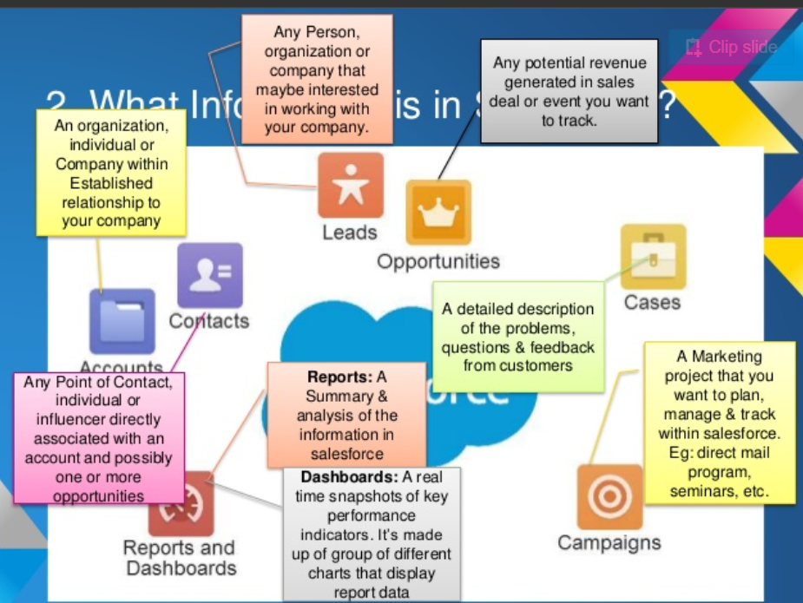
Main OOB entities in salesforce

Slide 13
View the object configuration
In salesforce applicaiton setup -> object manager
In schema browser
Workbench

Slide 14
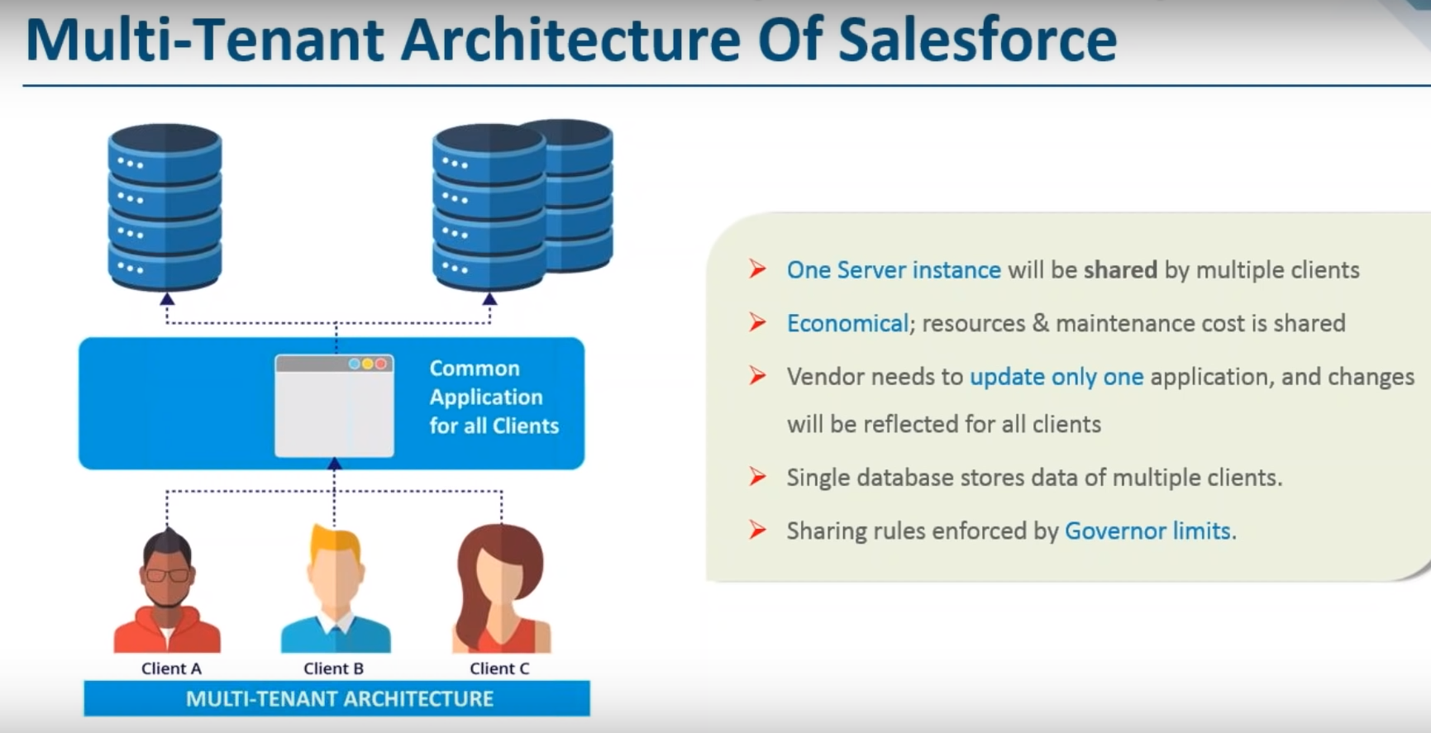

Slide 15
Salesforce Editions
Developer Edition
Personal Edition
Professional Edition
Enterprise Edition
Unlimited Edition

Slide 16
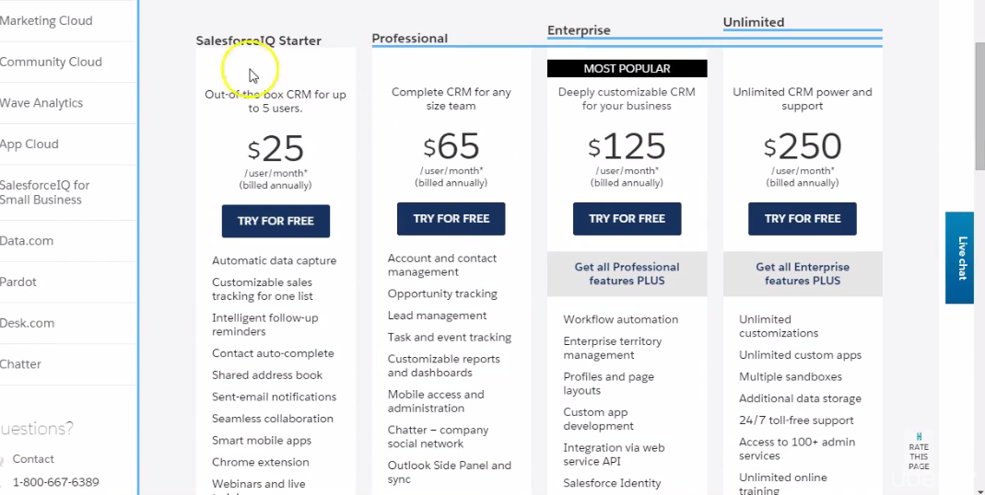
Salesforce Licenses

Slide 17
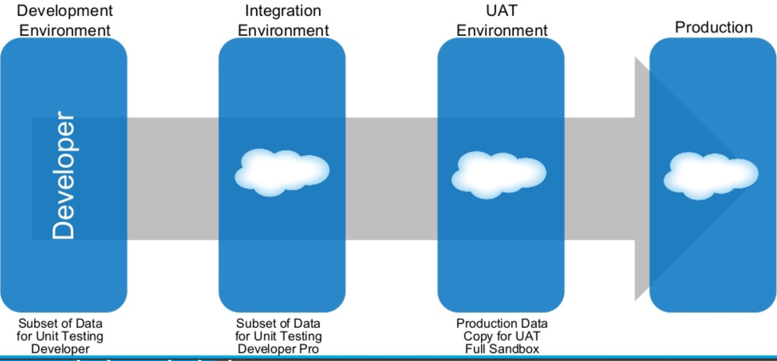
Sandboxes in salesforce

Slide 18
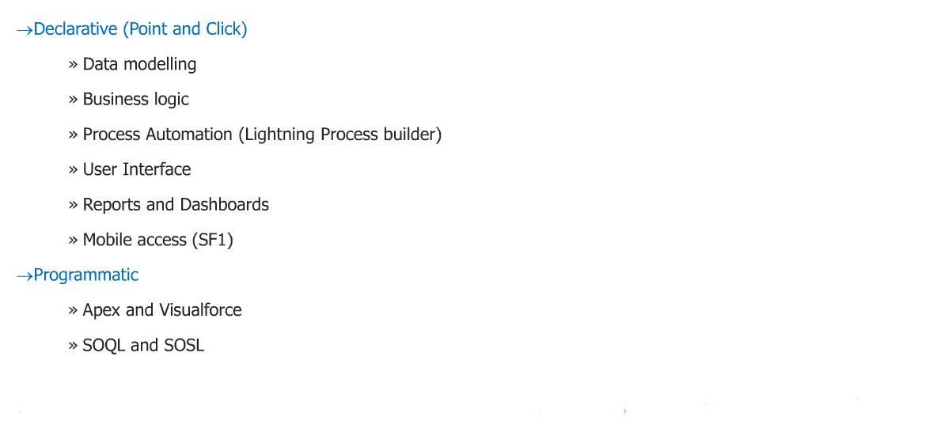
Key for developers: Click vs Code

Slide 19
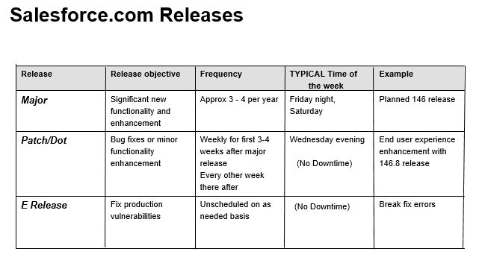

Slide 21
Main Parts of an salesforce application
App : is Group of related tabs towards a business function,example sales app,service app. Apps are a collection of Tabs.
Tabs:Point to an underlying table or Sobject in salesforce. They can be standard tabs or custom tabs. Example Account Tab,Lead Tab
Sobject:Table which stores the information of any entity
Fields and Records are part of sobject. Fields can be of differenct data types
Page Layouts :Every custom object will have a page layout automatically created,user can make changes to the layout
Record pages: For lightning ,record pages are used to show data ,contains many components . But object page layout is still used to render record detail data
Labs:Browse through standard app,build a custom app with few standard tabs .

Slide 22
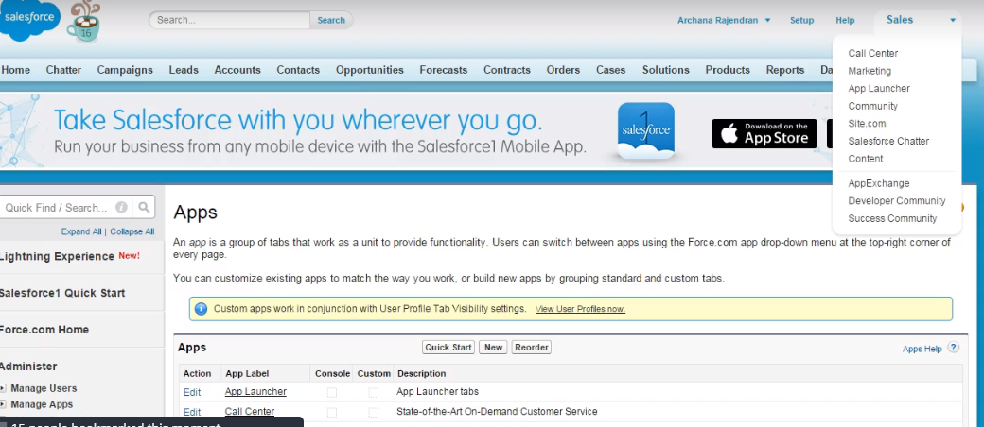
Apps

Slide 23
APPS
Apps
An app in Salesforce is a container for all the objects, tabs, processes, and services associated with a business function .
Standard apps
Salesforce provides standard apps such as Sales, Call Center, and Marketing.
Custom apps
A custom app can optionally include a custom logo.
Both standard and custom apps consist of a name, a description, and an ordered list of tabs.

Slide 24
Tabs
Tabs
A tab is a user-interface element which, when clicked, displays the record data on a page specific to that object.
Standard tabs
Salesforce provides tabs for each of the standard objects that are provided in the application when you sign up. For example, there are standard tabs for Accounts, Contacts, Opportunities, and so on:
Visibility of the tab depends on the setting on the tab display setting for the app.
Custom tabs
You can create three different types of custom tabs: Custom Object Tabs, Web Tabs, and Visualforce Tabs.

Slide 25
Tabs

Slide 26
Type of Objects
Standard objects
Salesforce provides standard objects in the application when you sign up and these include Account, Contact, Opportunity, and so on. These are the tables that contain the data records in any standard tab such as Accounts, Contacts, or Opportunities.
In addition to the standard objects, you can create custom objects and custom tabs.
Custom objects
Custom objects are the tables you create to store your data. You can create a custom object to store data specific to your organization. Once you have the custom objects and have created records for these objects, you can also create

Slide 27
Objects
Objects
Objects are a key element in Salesforce CRM as they provide a structure for storing data and are incorporated in the interface, allowing users to interact with the data.
Similar in nature to a database table, objects have properties such as:
Fields which are similar in concept to a database column
Records which are similar in concept to a database row
Relationships to other objects
Optional tabs which are user interface components to display the object data

Slide 28
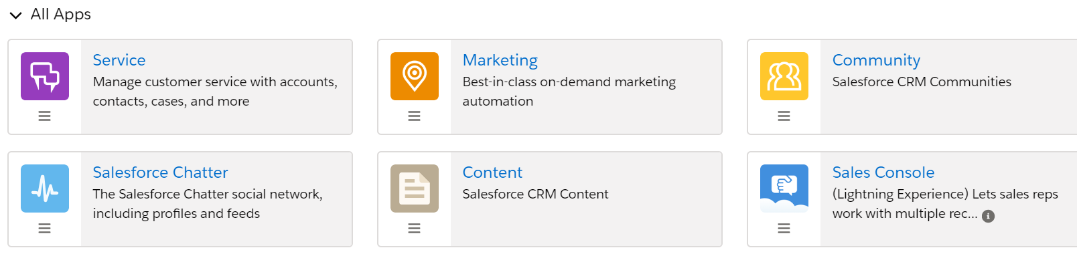
Apps in lightning

Slide 29
Basic Setup-Lab
Check your user profile and role in setup
Browse through the apps and tabs
Ensure you have access to classic and lightning interface
Setup company information .
Business hours ,holiday for response- will look at more detail in service cloud module

Slide 30
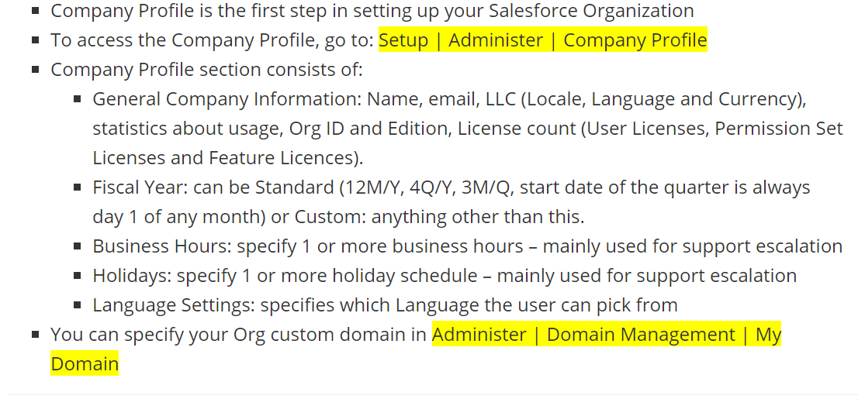
Lab:Company Profile Settings

Slide 31
Default Org settings
Default locale :The default locale setting affects the format of date, date/time, and number fields.
For example, a given date in the English (United States) locale would appear as 07/27/2012 and in the English (United Kingdom) locale as 27/07/2012.
However, individual users can set their own locale which will override the
Default time zone
This is the primary time zone in which your organization is located. The head-office location, for example.. However, individual users can set their own time zone which will override the organization-wide setting.
The Company Information page also displays all of the base licenses, active users, and feature licenses that have been purchased by your organization.

Slide 32
Locale: changes display of dates, times, numbers, First name, Last name, and addresses – for example, date (01-01-2016 vs January-01-2016), and number formatting…Locale is set in the company profile and user profile. User profile Locale Overrides Company Default.
Language: determines which language translatable elements (UI, fields, etc.) are displayed in to the user. User profile Language Overrides Company Default Language.
Time zone: determines the offset used to display time references in Salesforce (similar to changing the time zone on your computer). User profile Timezone Overrides Company Default Timezone.
Currency locale: configured org-wide unless multiple currencies is enabled. Determines the formatting of currency fields, and used to determine currency conversion when multiple currencies is enabled.
Currency controlled by this field, not the Locale one.
Note: Time Zone, Locale and Language are set-up in the Company information and are available in a user My Settings page. The user settings override the company settings. Also, the user can setup his default currency in case Multi-currency enabled.

